Slide 1
WERRINGTON AREA FORUM
SHORTLIST OF PROTECTED VIEWS

Slide 2
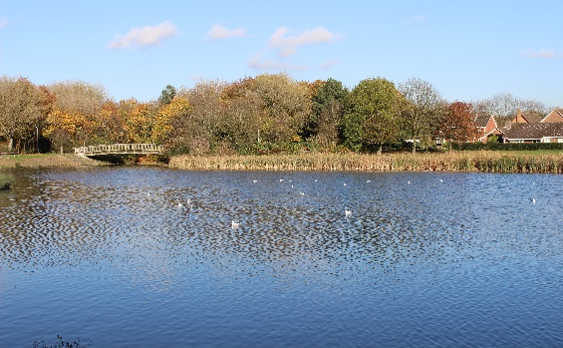
Cuckoos Hollow Looking towards the Bridge

Slide 3
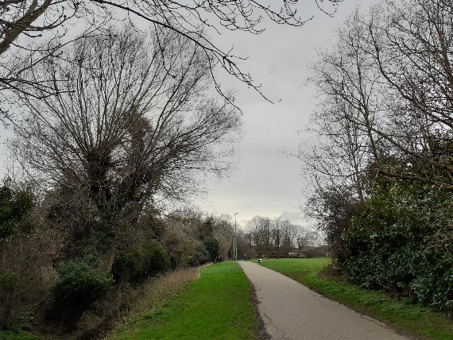
Cuckoos Hollow Cycle Path

Slide 4
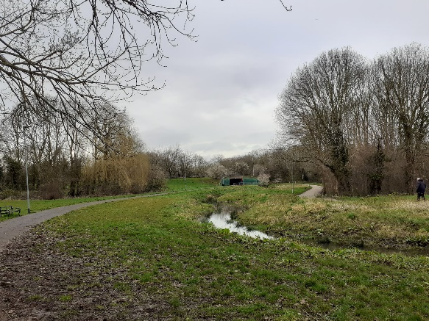
The Brook looking towards Fulbridge Road

Slide 5
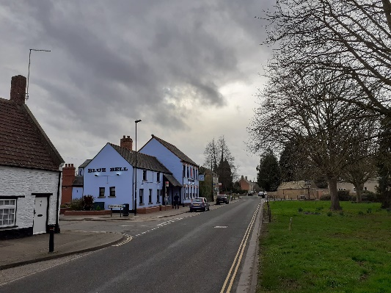
The Green

Slide 6
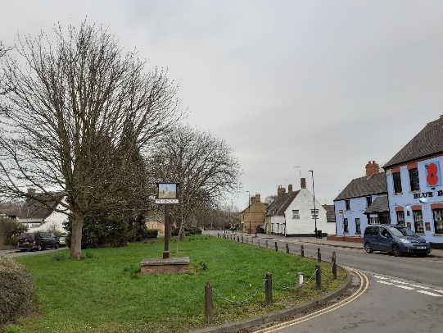
The Green

Slide 7
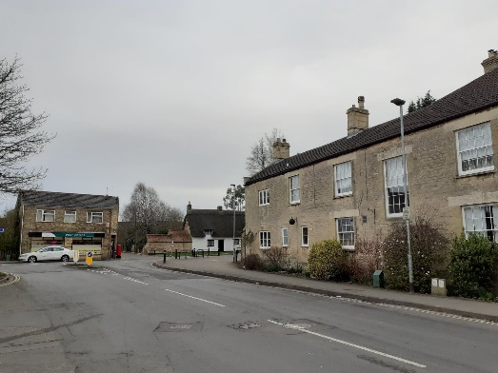
Hall Lane

Slide 8
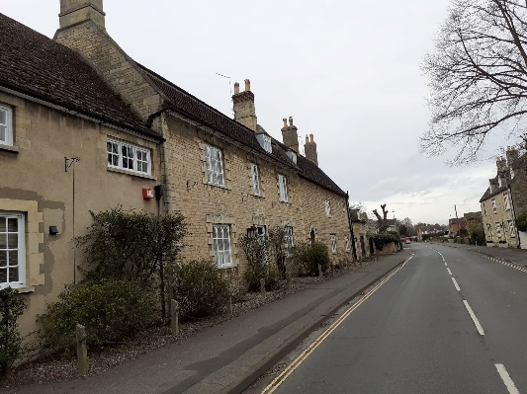
Hall Lane, Werrington Hall

Slide 9
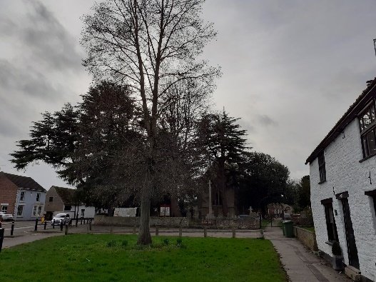
Church and green space

Slide 10
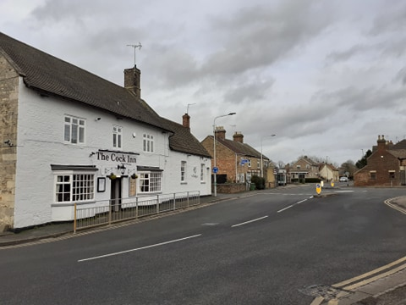
Cock Inn Corner

Slide 11
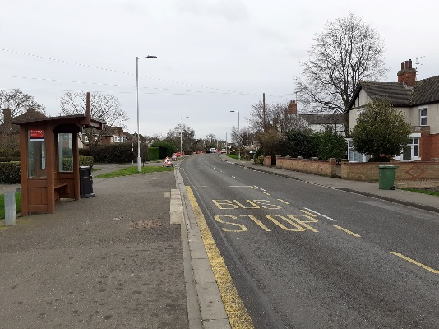
Lincoln Road looking south

Slide 12
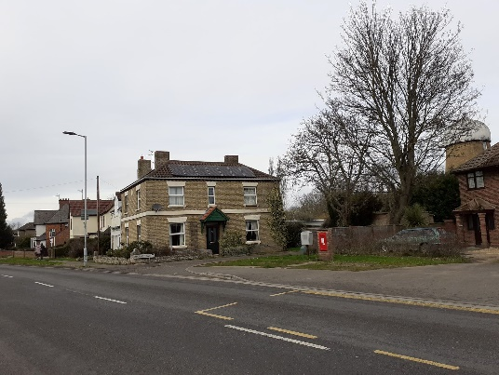
Windmill and Mill House

Slide 13
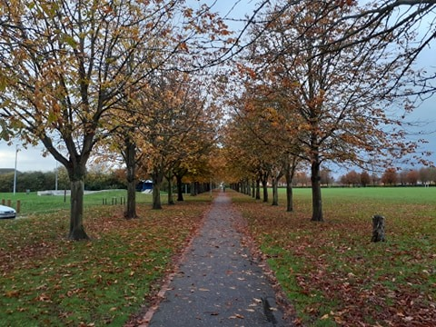
William Law Playing Fields

Slide 14
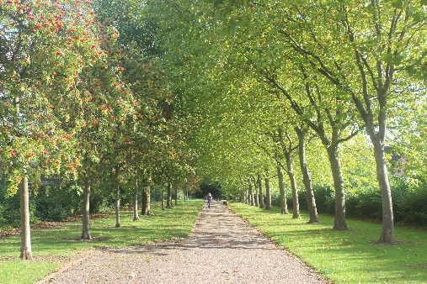
Sheldrick Walk from Twelve Tree Avenue

Slide 15
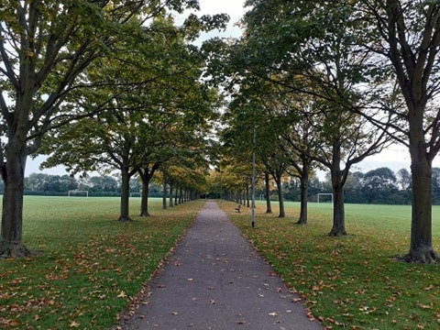
Ken Stimpson Playing Fields

Slide 16
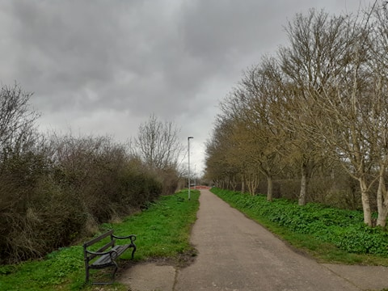
Fox Covert Looking Towards Davids Lane

Slide 17
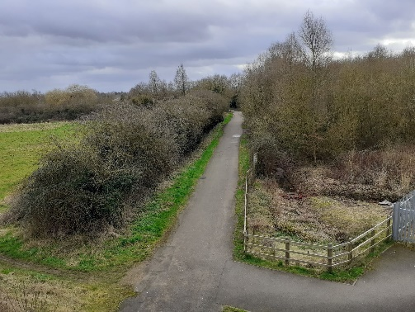
Fox Covert and Sobrite from railway bridge

Slide 18
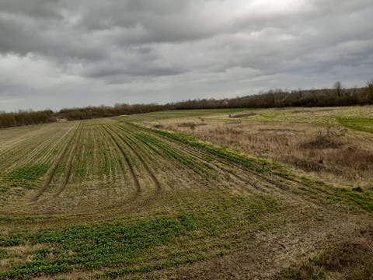
Newt Ponds from railway bridge

Slide 19
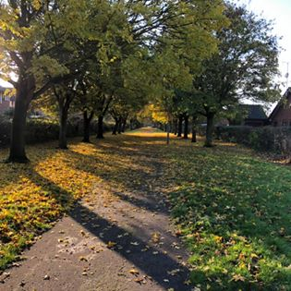
Woodhall Rise

Slide 20
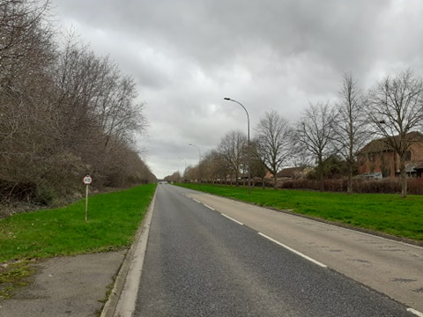
Davids Lane

Slide 21
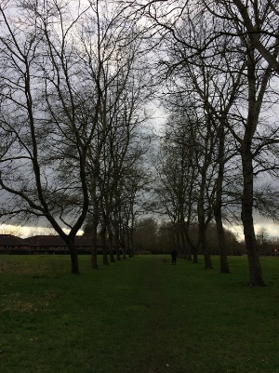
Rowlands Court

